Slide 1



SEMINAR PRESENTATION
ECON4490
FORECASTING FOR COVID-19 HAS FAILED
By Ioannidis, John P.A; Cripps, Sally; Tanner, Martin A.
Presented by: Sethulakshmi Kumbalathuparambil Sajeev
Notes:
Good afternoon, everyone, my seminar presentation is on the Article: Forecasting for COVID-19 has failed by these people (Ioannidis, John P.A, Cripps, Sally, Tanner, Martin A.)

Slide 2
Table of Content
01
Overview
02
The models used
03
Why the models failed?
04
How do we move forward?
05
What happened ?
06
The impacts
07
Recommendations
Notes:
You can quickly take a look at the road map here, starting with I will be giving a short overview and then we will move forward with the key topic like the models used, why they failed etc. and concluding with a Q&A session.

Slide 3

Overview
FOCUS: Analyzing the shortcomings in predicting COVID-19 outcomes.
The paper critically examines the failures in epidemic forecasting, with a focus on the prominent case of COVID-19.
It identifies various factors contributing to forecasting inaccuracies and explores potential remedies for improvement.
Notes:
First, this article is very interesting, it has a reply article written by the authors of the paper this article is being examined or criticized.
TBH reading this was like looking the comment section of a very controversial Instagram reel but more sophisticated and civil.
This article stands apart from the usual narrative of highlighting victories and positive outcomes.
Instead, it focuses on a significant blunder, the forecasting inaccuracies of covid 19 pandemic
COVID 19 pandemic that made us sit at home for almost 2 years, hit us all unexpectedly and caused a need of immediate policy decisions.
policymakers found themselves relying on outdated and questionable data
and the chaotic nature of the event led to oversight, missing crucial variables in the decision-making process.
This article stands apart from the usual narrative of highlighting victories and positive outcomes. Instead, it focuses on a significant blunder, dissecting a major mistake rather than celebrating success.
As we all know the COVID 19 pandemic that made us sit at home for almost 2 years,
this unfortunate event certainly hit us all unexpectedly and caused a need of immediate policy decisions.
policymakers found themselves relying on outdated and questionable data and in the chaotic nature of the event led to oversight, missing crucial variables in the decision-making process.
In essence, the urgency of the situation, coupled with the lack of real-time, accurate information, contributed to the dependence on less-than-ideal data for critical policy choices.

Slide 4

An analysis based on 72 major epidemics....
The analysis conducted by Cirillo and Taleb focused on 72 major epidemics (limited dataset)
Concluded that major epidemics exhibit a fat-tail pattern.
By selecting the 72 most-noticed outbreaks (Selection bias toward epidemics that were more prominent)
The sample is not reflective of the entire population of epidemics.
Exclude less noticeable or historically significant outbreaks (Skewed or inaccurate results)
Source: National Library of Medicine
Notes:
## Limited Dataset
Cirillo and Taleb's study focused on a dataset consisting of 72 major epidemics.
based on this they concluded that major epidemics exhibit a flat tail pattern.
the fat-tail pattern signals a greater risk of exceptionally serious outcomes compared to what a more typical, bell-shaped distribution might imply.
By selecting just the 72 major epidemics, they unintentionally introduced a selection bias...
moreover, The dataset's lack of representativeness raises concerns about its applicability to the entire population of epidemics.
Excluding less noticeable outbreaks could result in skewed or inaccurate conclusions, limiting the study's broader relevance.
(a fat-tail pattern suggests that there is a significant probability of experiencing highly severe or impactful events, such as a large number of infections, deaths, or other adverse consequences.)

Slide 5
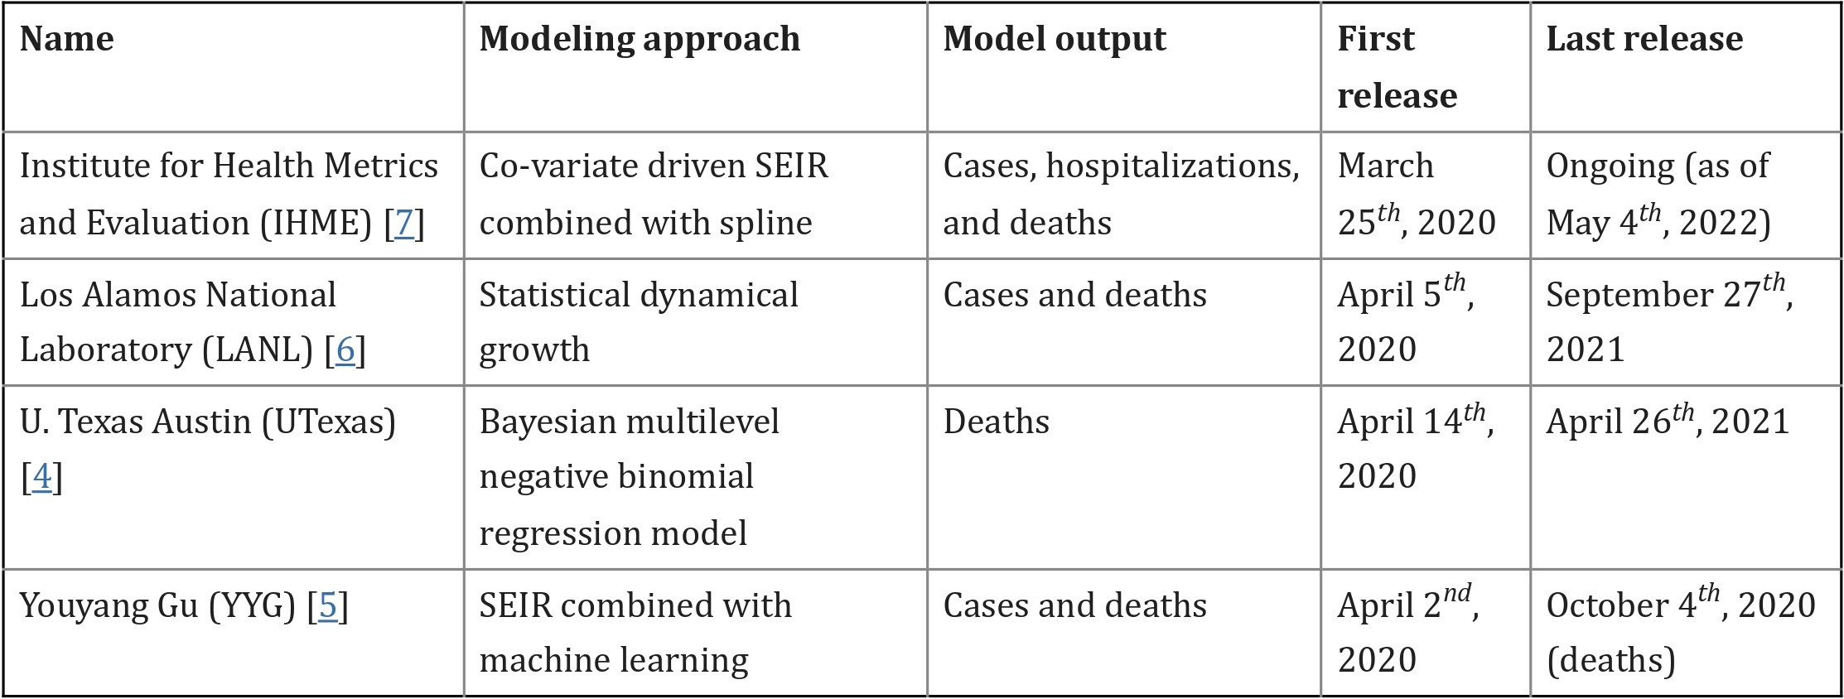
Selected Models
Source: Center for Systems Science and Engineering at Johns Hopkins University
Notes:
these are the specific models selected from the many models published.
the SEIR is a basic model used commonly in epidemiology.
Susceptible (S): Individuals in this compartment are not infected and can contract the disease if exposed to the infectious agent.
Exposed (E): Individuals in this compartment have been exposed to the infectious agent but are not yet infectious themselves. This represents the incubation period of the disease.
Infectious (I): Individuals in this compartment are infected and can transmit the disease to others.
Removed (R): Individuals in this compartment are removed from the transmission process, either because they have recovered from the infection and gained immunity or because they have succumbed to the disease.

Slide 6
More on the Modelling Approach...
Co-variate driven SEIR combined with spline:
Captures complex dynamics using flexible spline curves.
Statistical dynamical growth:
Considers changing parameters to adapt to evolving pandemic conditions.
Bayesian multilevel negative binomial regression model:
Utilizes Bayesian methods for parameter estimation.
SEIR combined with machine learning:
Enhances predictions by learning from diverse data sources.
Source: National Library of Medicine, Various studies
Notes:
Co-variate driven SEIR combined with spline model integrates the classic SEIR model with extra factors (covariates) like interventions, environmental conditions, etc.
The spline which is mathematical curve that is flexible and can bend to fit the data allowing the model to be more flexible, accommodating variations in the data that might not follow a straightforward pattern.
So essentially the model tries to simulate how a disease spreads through a population, considering not only the basic SEIR components but also accounting for external factors through covariates and using a spline to capture more intricate relationships in the data.
Statistical Dynamical Growth Model for COVID-19 is a statistical approach designed to provide insights into the changing patterns of COVID-19 cases and deaths. The model incorporates dynamic elements to account for the evolving nature of the pandemic. Statistical methods such as maximum likelihood estimation or Bayesian methods are used to estimate the model parameters based on historical data.
Bayesian multilevel negative binomial regression model combines the Bayesian approach which involves updating probabilities based on new evidence and Multilevel Modeling which acknowledges that data points may be grouped or nested within higher-level units.
Bayesian methods can perform well with small sample sizes. When data is limited, the inclusion of prior information can be particularly beneficial for making informed inferences.
That is, they can account for variability at different levels.
Moreover, Bayesian methods provide a natural way to quantify uncertainty.
Combining SEIR (Susceptible-Exposed-Infectious-Removed) models with machine learning techniques involves integrating the traditional epidemiological SEIR model with advanced machine learning algorithms.
Machine learning allows the incorporation of diverse data sources, including demographic information, mobility patterns, climate data, and other relevant features.
The combined model provides a more comprehensive understanding of the disease's spread by leveraging both epidemiological principles and data-driven insights.

Slide 7
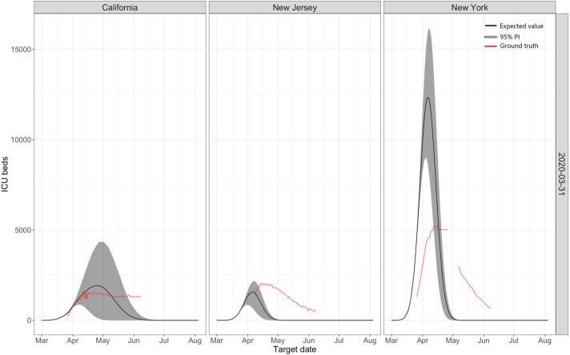
Fig. 1: Predictions for ICU Beds
Shows predictions made by IHME models on March 31 for three states: California, New Jersey, and New York.
Highlights the variability in model predictions, with instances of both overprediction and underprediction for different states.
Source: National Library of Medicine

Slide 8
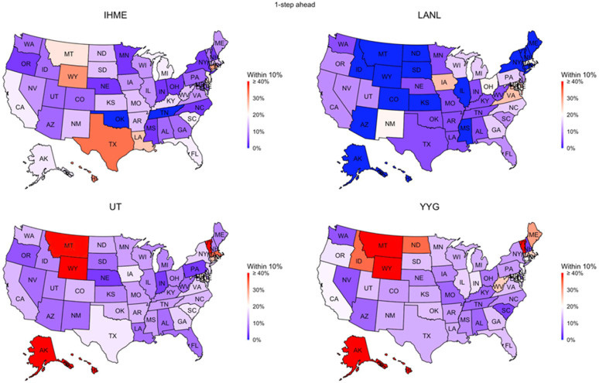
Fig. 2: Performance of Data-Driven Models for Death Counts
Compares the performance of four data-driven models (IHME, YYG, UT, LANL) in predicting COVID-19 death counts by state in the USA.
Indicates the percentage of times each model's prediction was within 10% of the actual count.
All models show a low level of accuracy, with less than 20% accuracy for most states.
Source: National Library of Medicine

Slide 9
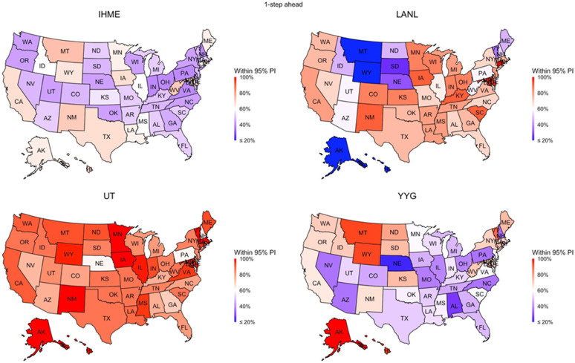
Fig. 3: Performance of Models in Uncertainty Quantification
Evaluates the performance of the same models in terms of uncertainty quantification.
Examines whether the models' assessment of uncertainty aligns with the actual outcomes.
Only the UT model approaches an accurate level of uncertainty quantification.
Source: National Library of Medicine

Slide 10
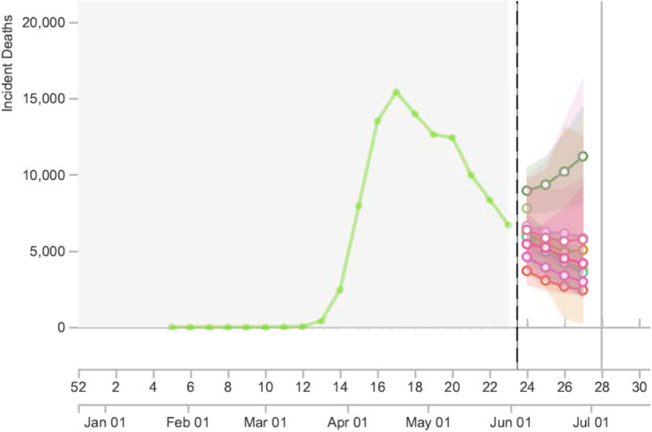
Fig. 4: Snapshot from COVID-19 Forecast Hub
Provides a snapshot from a forecasting hub that collates information and predictions from multiple models.
Illustrates the significant variation in predictions among eight different models for the number of US deaths during a specific week.
Showing a 4.5-fold difference in predictions and a wide range of 95% confidence intervals (almost a 200-fold difference).
Source: National Library of Medicine

Slide 11
Despite sophisticated modeling, predictions went wrong.....
Poor Data Input
Wrong Modeling Assumptions
High Sensitivity of Estimates
Lack of Epidemiological Features
Poor Past Evidence on Interventions
Selective Reporting
Lack of Transparency
Errors and Determinacy Issues
Single-Dimensional Focus
Lack of Expertise
Groupthink and Bandwagon Effects
Source: National Library of Medicine
Notes:
Poor Data Input: Inaccurate or incomplete information used for analysis.
Wrong Modeling Assumptions: Incorrect foundational beliefs or premises in the models.
High Sensitivity of Estimates: Small changes leading to significant deviations in predictions.
Lack of Epidemiological Features: Not considering disease patterns and characteristics in the modeling.
Poor Past Evidence on Interventions: Insufficient or unreliable historical data on the effectiveness of interventions.
Selective Reporting: Emphasizing extreme outcomes for attention or impact.
Lack of Transparency: Insufficient openness about methods, data, or code used in models.
Errors and Determinacy Issues: Mistakes in the models and challenges in achieving consistent results.
Single-Dimensional Focus: Concentrating on only one aspect of the issue, neglecting broader factors.
Lack of Expertise: Insufficient knowledge or experience in crucial disciplines.
Groupthink and Bandwagon Effects: Conforming to popular opinions or trends, even if they may be flawed.

Slide 12
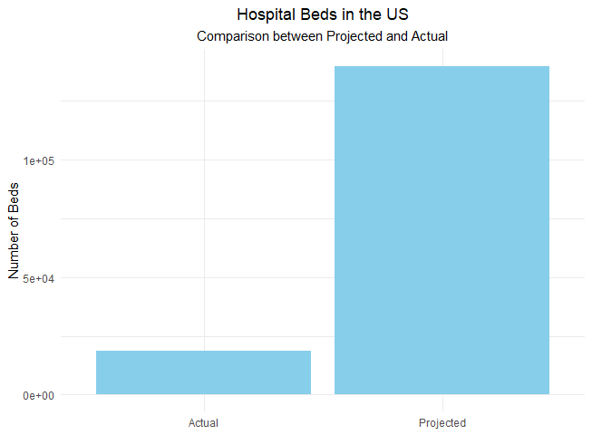
“Here’s my projection model. They were all wrong.”
~ Governor Andrew Cuomo
State of New York
Projections: 140,000 hospital beds, 40,000 intensive care units.
What Actually Happened: 18,569, far lower than the darkest expectations.
Data Source: COVID-19 Data Repository by the Center for Systems Science

Slide 13
Despite sophisticated modeling, predictions went wrong.....
Poor Data Input
Wrong Modeling Assumptions
High Sensitivity of Estimates
Lack of Epidemiological Features
Poor Past Evidence on Interventions
Selective Reporting
Lack of Transparency
Errors and Determinacy Issues
Single-Dimensional Focus
Lack of Expertise
Groupthink and Bandwagon Effects
Source: National Library of Medicine
Notes:
Poor Data Input: Inaccurate or incomplete information used for analysis.
Wrong Modeling Assumptions: Incorrect foundational beliefs or premises in the models.
High Sensitivity of Estimates: Small changes leading to significant deviations in predictions.
Lack of Epidemiological Features: Not considering disease patterns and characteristics in the modeling.
Poor Past Evidence on Interventions: Insufficient or unreliable historical data on the effectiveness of interventions.
Selective Reporting: Emphasizing extreme outcomes for attention or impact.
Lack of Transparency: Insufficient openness about methods, data, or code used in models.
Errors and Determinacy Issues: Mistakes in the models and challenges in achieving consistent results.
Single-Dimensional Focus: Concentrating on only one aspect of the issue, neglecting broader factors.
Lack of Expertise: Insufficient knowledge or experience in crucial disciplines.
Groupthink and Bandwagon Effects: Conforming to popular opinions or trends, even if they may be flawed.

Slide 14
Did we vastly overreact to a single bad projection?
Historic job losses followed, 500,000 in the first week alone.
By April 13, nearly 6 million Canadians had applied for emergency benefits.
Global supply chains disruption.
Delays in the production and transportation of goods led to shortages and increased costs.
International trade & investments were impacted, leading to a synchronized global economic slowdown.

Slide 15
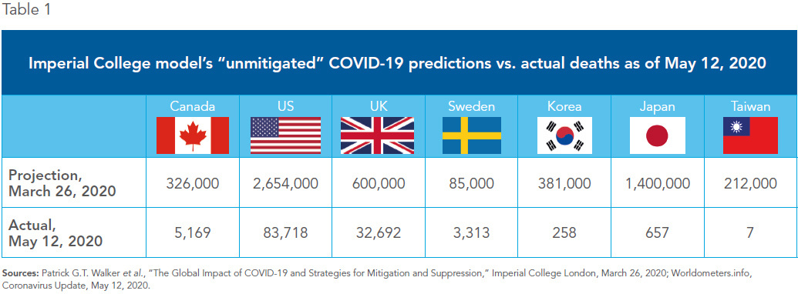
“It wasn’t so much the numbers themselves, frightening though they were, as who reported them: Imperial College London.”
~ The New York Times
Source: Montreal Economic Institute

Slide 16
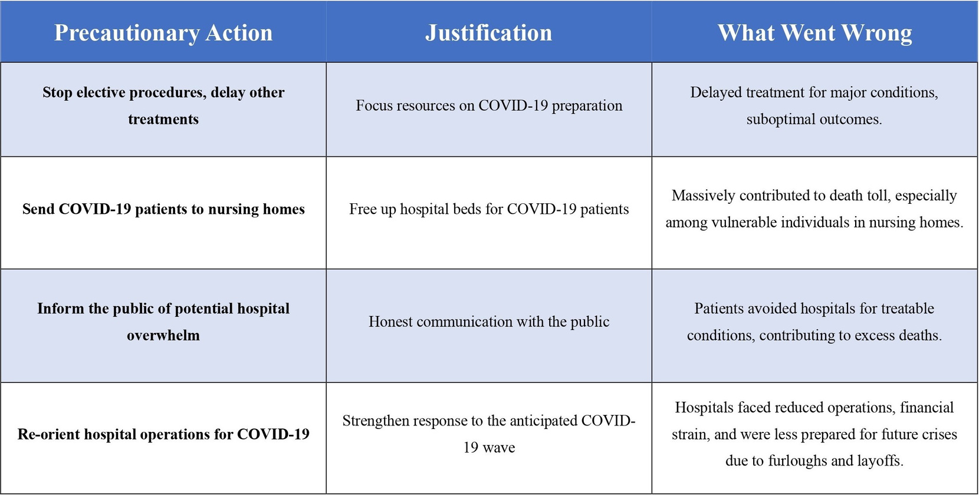
Adverse Consequences of Precautionary Actions during the COVID-19 Pandemic
Source: National Library of Medicine

Slide 17
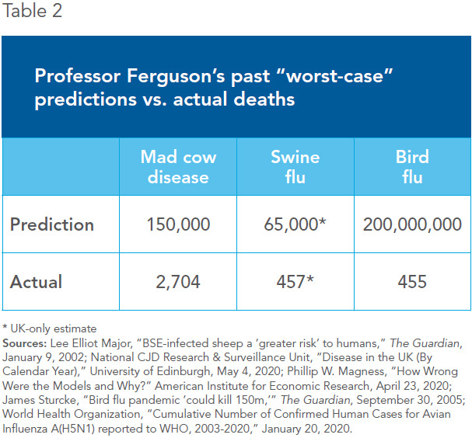
A track record of errors; the practice continues to thrive
“ Canada and other countries may have adopted overly drastic measures due to a single bad projection ”
Source: Montreal Economic Institute

Slide 18
How to Improve Epidemic Forecasting ?
Investment in the collection, cleaning, and curation of data.
Models that consider multi-criteria objective functions.
Factoring economic, and social impacts.
This trade-off requires involving economic experts as well as epidemiologists.
Promote data and code sharing to check the stability of stochastic processes.
Focus on precise, focused measures based on more current evidence.

Slide 19

Any questions ?

Slide 20
Reference:
Arons M.M., Hatfield K.M., Reddy S.C., Kimball A., James A., et al. Presymptomatic SARS-CoV-2 infections and transmission in a skilled nursing facility. New England Journal of Medicine. 2020;382:2081–2090. [PMC free article] [PubMed] [Google Scholar]
Chin V., Ioannidis J.P.A., Tanner M., Cripps S. 2020. Effects of non-pharmaceutical interventions on COVID-19: A Tale of Two Models. medRxiv. [CrossRef] [Google Scholar]
Cirillo P., Taleb N.N. Tail risk of contagious diseases. Nature Physics. 2020 doi: 10.1038/s41567-020-0921-x. [CrossRef] [Google Scholar]
Danis K., Fonteneau L., Georges S., et al. High impact of COVID-19 in long-term care facilities, suggestion for monitoring in the EU/EEA. Euro Surveillance. 2020;25(22) doi: 10.2807/1560-7917.ES.2020.25.22.200095. pii=2000956. [PMC free article] [PubMed] [CrossRef] [Google Scholar]
Ferguson N.M., Donnelly C.A., Anderson R.M. The foot-and-mouth epidemic in great britain: Pattern of spread and impact of interventions. Science. 2001;292:1155–1160. [PubMed] [Google Scholar]
Ferguson N.M., Ghani A.C., Donnelly C.A., Hagenaars T.J., Anderson R.M. Estimating the human health risk from possible BSE infection of the british sheep flock. Nature. 2002;415:420–424. [PubMed] [Google Scholar]
IHME COVID-19 health service utilization forecasting team, Murray Christopher J.L. 2020. Forecasting COVID-19 impact on hospital bed-days, ICU-days, ventilator-days and deaths by US state in the next 4 months. medRxiv 2020, [CrossRef] [Google Scholar]
Ioannidis J.P. Boston Review; 2020. The Totality of the Evidence. Retrieved from http://bostonreview.net/science-nature/john-p-ioannidis-totality-evidence. (Accessed 2 June 2020) [Google Scholar]
Ioannidis J.P. STAT; 2020. A fiasco-in-the-making? As the Coronavirus pandemic takes hold we are making decisions without reliable data. Retrieved from https://www.statnews.com/2020/03/17/a-fiasco-in-the-making-as-the-coronavirus-pandemic-takes-hold-we-are-making-decisions-without-reliable-data/. (Accessed 18 June 2020) [Google Scholar]
Ioannidis, John P. A. (2020c). Interview given on March 22 to in2life.gr: An external file that holds a picture, illustration, etc.
Object name is fx1_lrg.gif (“The lockdown is the correct decision, but…”): An external file that holds a picture, illustration, etc.
Object name is fx2_lrg.gifAn external file that holds a picture, illustration, etc.
Object name is fx3_lrg.gif (the stringent measures that are taken at this phase are necessary because it seems that we have lost control of the epidemic, https://www.in2life.gr/features/notes/article/1004752/ioannhs-ioannidhs-sosth-tora-h-karantina-alla-.htm. (Accessed 18 June 2020).
Ioannidis J.P. Coronavirus disease 2019: The harms of exaggerated information and non-evidence-based measures. European Journal of Clinical Investigation. 2020;50 [PMC free article] [PubMed] [Google Scholar]
Ioannidis J.P.A., Axford C.A., Contopoulos-Ioannidis J.P. Population-level COVID-19 mortality risk for non-elderly individuals overall and for non-elderly individuals without underlying diseases in pandemic epicenters. Environmental Research. 2020;188 article 890. [PMC free article] [PubMed] [Google Scholar]

Slide 21
Appendix:

Slide 22



PREDICTIONS AND REALITY
New York Prediction
Tennessee Prediction
Forecasted need: Up to 140,000 hospital beds and 40,000 ICU units.
Reality: Intensive care bed usage declined, total hospitalized lower than expected.
Projection: Peak on April 19, needing 15,500 inpatient beds, 2,500 ICU beds, and 2,000 ventilators.
Reality: Peak four days earlier, requiring significantly fewer resources than projected.
California Prediction
Projected need: 1.2 million hospitalizations, requiring 50,000 additional beds.
Reality: COVID-19 patients occupied fewer than 20% of ICU beds, and general hospital bed usage was well below 5%.
"Here’s my projection model. They were all wrong."
~ Governor Cuomo

